Slide 1

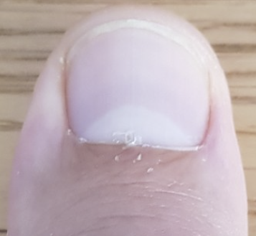
Engineer
Task A: Precision in engineering
1) Read these measures.
a)
0
in
1
2
3
b)
0
in
1
2
3
c)
0
in
1
2
3
2) Use a rule of thumb to measure out the below:
a) One and three eighths of an inch.
b) Two and three sixteenths of an inch.

Slide 2
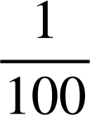
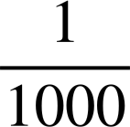
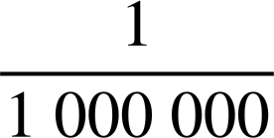
Engineer
3) a) How many millimetres in a centimetre?
One centimetre
m
1 × 10⁻² m
One millimetre
m
1 × 10⁻³ m
b) How many micrometres in a millimetre?
One micrometre
m
1 × 10⁻⁶ m
c) How many micrometres in a centimetre?
d) Engineers can laser cut to a precision of 2.5 × 10⁻⁵ m
What fraction of a centimetre is this?
Task B: Other applications of maths
1) Show whether each of these walls is upright.
a)
b)
c)
50 cm
40 cm
13 yd
5 ft
12 yd
4 ft
30 cm
3 ft
5 yd

Slide 3
Engineer
2) Explain how we know this corner is not ‘right’.
5 ft
3 ft
4 ft
3) Engineers today use Pythagoras to calculate lengths. Find all the missing lengths of the girders on this bridge. The design is symmetrical.
10 m
48 m
15 m
9 m
Mathematics in Education and Industry
v2.4

